Slide 1
Maximizing Revenue For Drivers
Through Payment Type

Slide 2
Agenda
Problem Statement
Research Question
Data Overview
Methodology
Analysis and Findings
Hypothesis Testing
Recommendations

Slide 3
Problem Statement
In the fast-paced taxi booking sector, making the most of revenue is essential for long-term success and driver happiness.
Our goal is to use data-driven insights to maximize revenue streams for taxi drivers in order to meet this need. Our research aims to determine whether payment methods have an impact on fare pricing by focusing on the relationship between payment type and fare amount.

Slide 4
Research Question
Is there a relationship between total fare amount and payment type ?
Can we convince customers towards payment methods that generate higher revenue for drivers , without negatively impacting customer experience ?

Slide 5
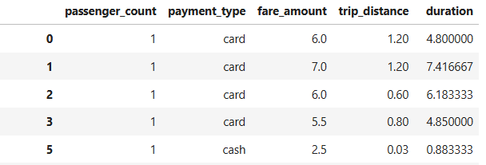
Data Overview
passenger_count
payment_type
fare_amount
trip_distance
duration

Slide 6
Methodology
Step | Description
Descriptive analysis | Perform statistical analysis to summarize key aspects of the data, focusing on fare amounts and payment types.
Hypothesis testing | Conducted a T - test to evaluate the relationship between payment type and fare amount, testing the hypothesis that different payment methods influence fare amounts.

Slide 7
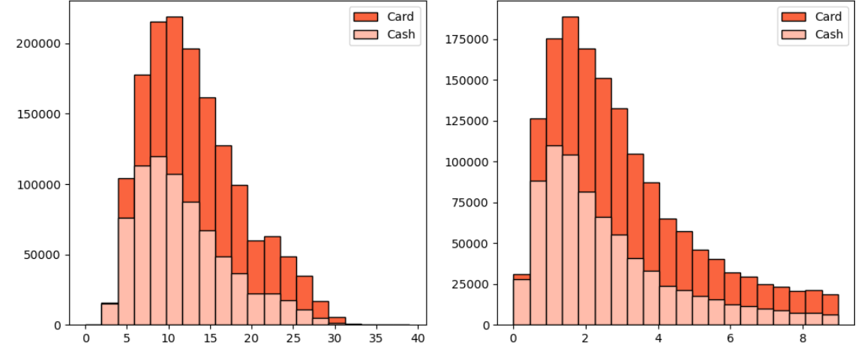
Key Insights
Customers paying with cards tend to have a slightly higher average trip distance and fare amount compared to those paying with cash.
Fare Amount
Trip Distance

Slide 8
Insight
The data indicates that customers prefer to pay more with cards when they have high fare amount and long trip distance.
 | Payment Type | Mean | Standard Deviation
Fare Amount | Card | 13.1 | 5.84
 | Cash | 11.75 | 5.61
Trip distance | Card | 2.99 | 1.99
 | Cash | 2.60 | 1.91

Slide 9
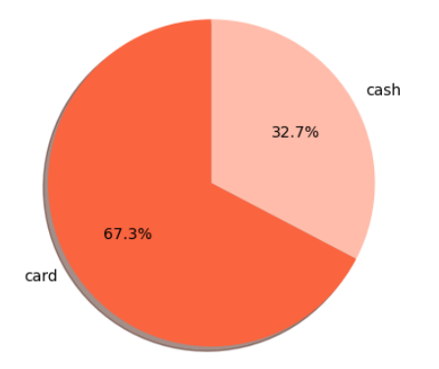
Preference Of Payment Types
The proportion of customers paying with cards is significantly higher than those paying with cash, with cards payments accounting for 67.5% of all transactions compared to cash payments at 32.5%.
This indicates a strong preference among customers for using card payments over cash, potentially due to convenience, security or incentives offered for card transactions.

Slide 10
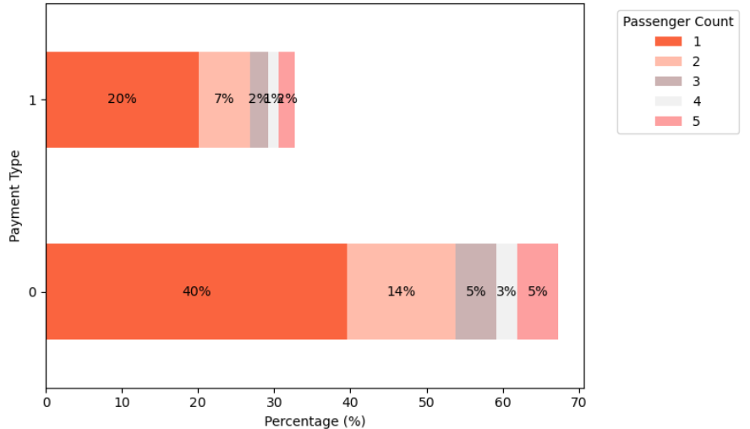
Passenger Count Analysis
Among card payments raids with a single passenger(passenger_count =1) comprise the largest proportion , constituting 40.08% of all card transactions.
Similarly, cash payments are predominantly associated with single passenger rides, making up 20.04% of all cash transactions.
There is a noticeable decrease in the percentage of transactions as the passenger count increases, suggesting the large groups are less likely to use taxis or may opt for alternative payment methods.
These insights emphasize the importance of considering both payment method and passenger ground when analyzing transaction data, as they provide valuable insights into customer behavior and preferences.

Slide 11
Hypothesis Testing
Null hypothesis – There is a difference in average fare between customers who use credit cards and customers who use cash.
Alternative hypothesis - There is a difference in average fare between Customers who use credit cards and customers who use cash.
With a T – statistic of 165.5 and a P- value of less than 0.05 , we reject the null hypothesis, suggesting that there is indeed a significant difference in average fare between the two payment methods.

Slide 12



Recommendations
Encourage customers to pay with credit cards to capitalize on the potential for generating more revenue for taxi cab drivers.
Implement strategies such as offering incentives or discounts for credit cards transactions to incentivize customers to choose this payment method.
Provide seamless and secure credit card payment option to enhance customer convenience and encourage adaption of this preferred payment method.

Slide 13
Thank You

